Slide 1
Group-10 The OG’s
Vatsal Shah-AU2040019 Ushmay Patel-AU2040253
Nihaar Patel-AU2040182 Deep Patel-AU2040250
Project Domain: Network Flow
Project Title: FINDING STEADY STATE OF NETWORK FLOW USED FOR OPTIMIZING SEARCH ENGINE RESULTS

Slide 2
Introduction
Our main objective of the project is to explore steady state analysis of network flow.
Steady state analysis means repetitive analysis of a flow in network till it reaches the steady state.
PageRank works to give more appropriate and “more important page” or accurate search results when random click or search is executed based on score of PageRank.
Incase of network flow there is predefined flow, after multiple iterations it reaches steady state viz steady state of network flow.
PageRank score or rank is associated with value of network flow to node in steady state.

Slide 3
Problem Statement
‘Finding Steady State of a Network flow’.
Page Rank to illustrate the Search Engine Results and asserting the fact that Steady state is one of the Eigenvectors of the Matrix.
The most prominent webpage that we will get after searching will be optimized solution using pagerank algorithm and concept of network flow.

Slide 4
Steady State Calculation
We first calculated the eigenvalues and eigenvectors of the matrix.
Now we decompose the matrix to (P)*(D)*(P^(-1)) where P contains the eigenvectors of A; Whereas D is diagonal matrix containing eigenvalues of A
Now we scale it to kth degree so that 〖(A〗^k)=(SD^k S^(-1))
Now once we get 〖(A〗^k⋅U_0)=〖(U〗_k) which was our equation
After a certain number of iterations when the value starts to plateau we can say that the network has attained a steady state.
This means the vector that we finally get is the vector that represents the rank of the nodes in the given graph, which is useful in ranking them from the highest to lowest.

Slide 5
Functioning of code
We input the input matrix in the code with respect to the assumptions and limitations.
Then we find the eigenvalues and eigenvectors of the input matrix.
The eigen space then is further diagonalized with ‘k’ iterations up until it reaches steady state.
Now here in our strategy to reduce time complexity we apply the fact that while scaling (P)*(D)*(P^(-1)) and multiplying it again with (P)*(D)*(P^(-1)) the (P)(P^(-1)) results for an identity matrix.
This optimizes our approach as we use the naïve multiplication algorithm which takes O(n^3) complexity.

Slide 6
Why this approach works?
This approach works because the probability of number of visitors/ data going from one node to another depends upon the previous iteration.
The flow also depends upon a node's connection with other important nodes
This approach works because of the. In a matrix, the probability is are Eigen Centrality Concept designated to nodes. There will be a dominant Eigenvalue for which the flow attains a Steady State
We capitalize on this fact that rank of a node only depends on the previous rank. So we find the eigenvalues and eigenvectors to exponentiation in order to iterate.

Slide 7
What we get from the code ?
The symmetric matrices do give a steady state where the vectors that represents the Steady State is (1, 1, 1, ….).
The non- symmetric matrices do give out the percentage of population/ data that is present at the saturation/ steady state of the flow.
The steady state also speaks about page rank in which the value of each node which is a web page shows what numbers of visitors are going to stay on a given node and what number are going to transit.
This helps in deciding the relevancy of the pages.

Slide 8
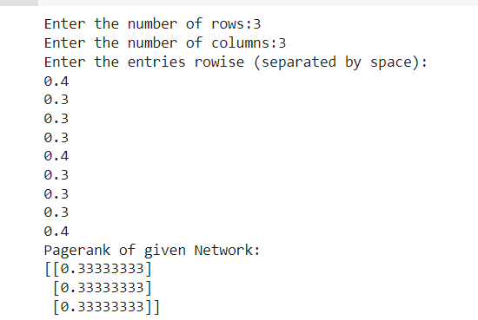
Result of our codes

Slide 9
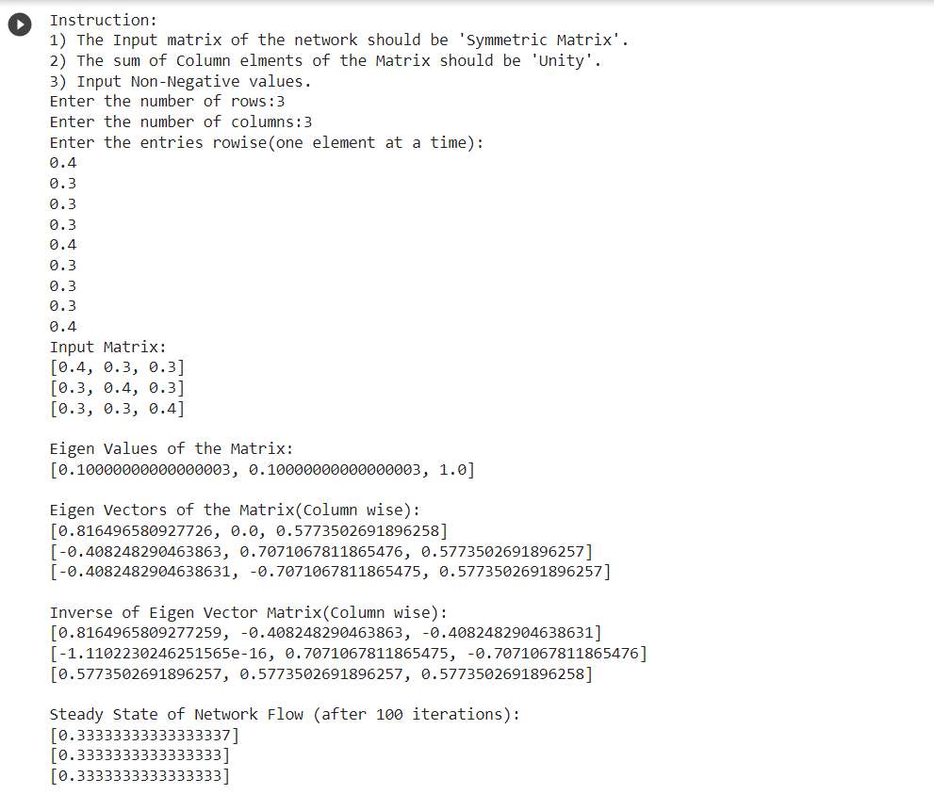

Slide 10
Conclusion
The symmetric matrices give steady state when vectors are in steady state.
•The non- symmetric matrices do give out the percentage of population/ data that is present at the saturation/ steady state of the flow.
• Steady state also helps in giving the rank of the page a person visits based on number of visits done and based on relevance.

Slide 11
Contributions
AU2040019 - Vatsal Shah
Coding
Writing Report
Research about Pagerank Algorithm
Research about Jacobi Algorithm
AU2040250 - Deep Patel
Coding
Writing Report
Research about Markov Chain and Steady state analysis.
Research about Eigenvalues and Eigenvectors.

Slide 12
AU2040253 - Ushmay Patel
Coding
Writing Report
Connection of web pages
Research about Pagerank Algorithm
AU2040182 - Nihaar Patel
Coding
Writing Report
Research about Markov Chain and Steady state analysis.

Slide 13
References
Online help. Steady State Vector of a Markov Chain - Maple Help. (n.d.). Retrieved November 24, 2021, from https://www.maplesoft.com/support/help/maple/view.aspx?path=examples%2FSteadyStateMarkovChain#:~:text=A%20common%20question%20arising%20in,vector%20of%20the%20Markov%20chain.
Math 312 - markov chains, Google's PageRank algorithm. (n.d.). Retrieved November 24, 2021, from https://www2.math.upenn.edu/~kazdan/312F12/JJ/MarkovChains/markov_google.pdf.
Using row reduction to calculate the inverse and the ... (n.d.). Retrieved November 24, 2021, from http://www.math.pitt.edu/~annav/0290H/row_reduction.pdf.
Andrew Chamberlain, P. D. (2017, October 4). Using eigenvectors to find steady state population flows. Medium. Retrieved November 24, 2021, from https://medium.com/@andrew.chamberlain/using-eigenvectors-to-find-steady-state-population-flows-cd938f124764.
Machado Google PageRank Linear Algebra Project - UNCG. (n.d.). Retrieved November 24, 2021, from https://mathstats.uncg.edu/sites/yasaki/publications/machado-google-pagerank-linear-algebra-project.pdf.
D. S. (2019, July 16). Introduction to markov chains. Medium. Retrieved November 25, 2021, from https://towardsdatascience.com/introduction-to-markov-chains-50da3645a50d.
Page rank algorithm and Implementation. GeeksforGeeks. (2021, November 6). Retrieved November 25, 2021, from https://www.geeksforgeeks.org/page-rank-algorithm-implementation/.

